Slide 1


Autism ACHIEVE Alliance
Using research and local knowledge to develop an autism pathway

Slide 2
Plan
Key components of an effective pathway for ASD
The draft pathway
Guidance
Proformas
Steps towards a new pathway

Slide 3
What did the research say makes a difference?

Slide 4
Key components of an effective pathway
A local diagnostic service can be effective and efficient if it has 7 key components:
adherence to quality and waiting time standards
good data
a local action plan and implementation group
a local multi-disciplinary evidence based pathway
flexible approaches to assessment (core/ complex)
triage and referral management
a training and mentoring plan
Notes:
Research we have undertaken over the last 7 years and a thorough review of evidence available together with practice experience, leads us to conclude that these are the important things that need to be in place

Slide 5

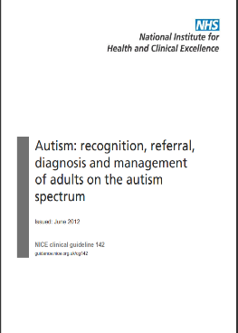
1. Adhere to quality standards
Intervention and support should be independent of diagnosis
ASD Clinical guidelines inform pathways:
    Diagnostic assessment tools/ process at each stage
    DSM and ICD
Adherence to guidelines does not increase waiting times
Need to know, nice to know

Slide 6
1. Waiting time standards
NICE recommends:
  12 weeks from referral for ASD assessment to start of assessment
NAP-C recommends:
  17 weeks (119 days)from referral to diagnosis shared in most cases
  23-25 weeks in the most complex cases
Notes:
These are the National guidelines that exist
You are obviously still a long way from this and we may need to have further discussion to agree steps towards a target like this

Slide 7
1. Waiting times
Autism ACHIEVE Alliance (Child services)
Wait from referral to diagnosis shared:
332 days and 74% exceeded NAP-C standard
Wait from referral accepted to diagnosis shared
  Core pathway: = 17 weeks
  Complex pathway: 30 weeks
Notes:
When we did our research with services in Scotland, many services did not/ do not know current waiting times or duration of assessment.
Autism ACHIEVE Alliance (2011-12) studied services across Scotland and found the total wait from referral to diagnosis shared:

Slide 8

2. Good data
WAITS

Slide 9

Know your waits – all three of them
referral for specialist assessment
Diagnosis
Diagnosis Shared
1st appointment
1
2
3

Slide 10
Data on demand and capacity
How do you measure the demand?
Number of children referred for ASD assessment each year?
How long they wait for diagnosis from referral?
Duration of the diagnosis process?
How many appointments do you need to provide each month?
How do you measure your capacity?
What capacity does your multi-disciplinary diagnostic service need to provide to meet demand?
Skill level
Number of appointments that can be offered

Slide 11
3. Action plans to reduce waits:

Slide 12
4. Evidence based pathways
Model pathways are available:
Process for Pathway development
  Multi-disciplinary
  Scoping and dedicated staff time
  Local Action Planning
  Implementation and Review Group
  A plan to support staff with the change the new pathway brings

Slide 13

5. Flexible approaches to assessment

Slide 14
Core components of ASD assessment
2. Clinical History
3. Contextual Assessment
Map to DSM 5
1. Clinical Observation

Slide 15
A ‘Core’ assessment pathway
Includes core components of assessment
Multi-disciplinary
Same support and information
Local clinicians complete assessment and share diagnosis
Increased training and capacity in local SLT, CCH and CAMHS teams
Relevant for 25% of all ASD assessment referrals

Slide 16
‘Complex’ assessment pathway
Includes
Same core components of multi-disciplinary assessment and information
Assessment information in relation to complexity:
  Learning disability, ADHD, Other co-morbidities
  Family or Social complexity
  Discrepancy between reports/ assessments/ opinions
Use of Standardised Tools (e.g. ADOS, ADI-r)
ASD ‘enhanced or expert level’ clinicians complete assessment and share diagnosis
Relevant for 75% of all ASD assessment referrals

Slide 17
Flexible use of standardised tools
Proformas vs standardised tool?
Contextual assessment tools can identify discrepancy/ agreement between home and school (e.g. SRS/ GARS)
    If no discrepancy, no need for school observation by diagnostic team
    If discrepant and school not identifying challenges – carry out skilled, ADOS informed observation

Slide 18
6. Triage and referral management
  Multi-disciplinary
  Most experienced staff
  Time saving
  Consider complexity and skills mix required early in the process
  Avoid duplication of waits and “pillar to post” scenarios
  Builds shared expectations between services
  Ongoing support and management of change

Slide 19
6. Referral management: Using time effectively
  Reduce number of contacts
  Set expectations for referrers about information they need to send
  Train and inform referrers
  Provide feedback
  Send out tools to gather key information in advance of 1st appointment
  From colleagues
  From Questionnaires (e.g. SRS, GARS)

Slide 20
Referral Management
Consider how many receive a positive diagnosis of ASD after being in the pathway
Cornwall 60% receive a positive diagnosis of ASD
Argyll 43%
Lothian 84% positive diagnosis of ASD

Slide 21
6. Referral management: Using time effectively
Training referrers
Triage
Use proformas for assessment and information gathering
  Consistency
  Less duplication
Shared case notes and up to date record keeping
Separate diagnostic assessment from other support
Allow staff dedicated time for ASD assessment
  25-50% of community referrals include an ASD query
  Does your resource match need?
Implement DNA strategies

Slide 22
What is the impact of research on practice?

Slide 23
We can reduce the wait
  QMU research reduced waits in 11 adult services
  Introduced innovative diagnostic practices to increase quality and efficiency
  Average wait reduced from 147 to 119 days
  NHS Lothian (population 800,000) introduced pathway based on QMU research
  With 800 referrals per year
  Average wait reduced from 270-122.5 days over a 2 year period
Notes:
Typically research evidence takes about 20 years to filter into practice, and we know that the problem of how we reduce waits is a complex one
However we have been able to demonstrate some immediate impact of our research on practice in Scotland

Slide 24
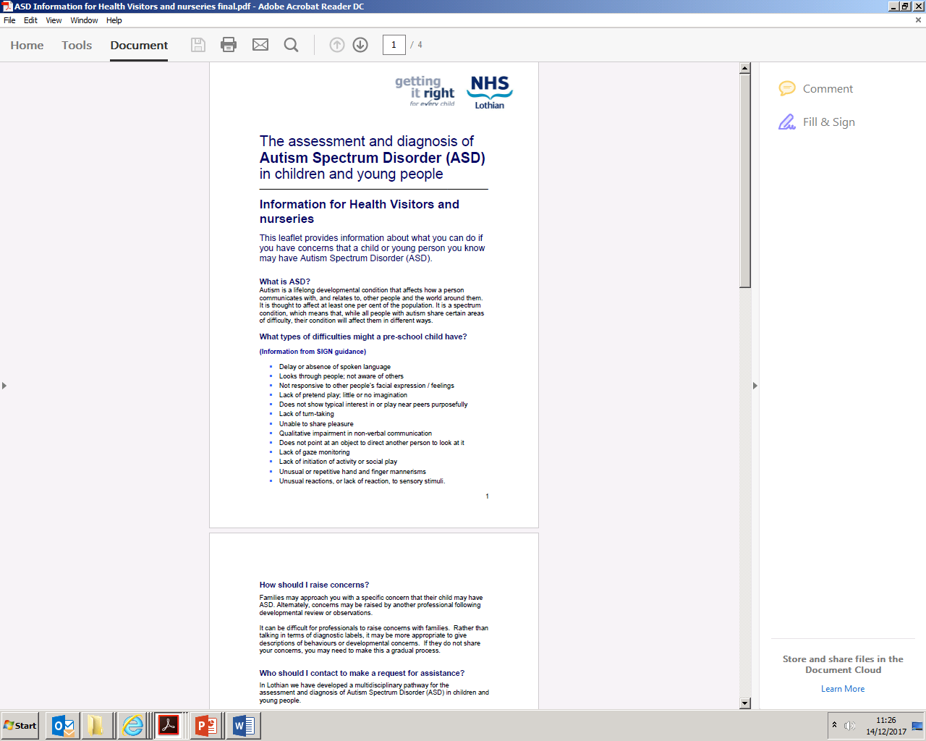
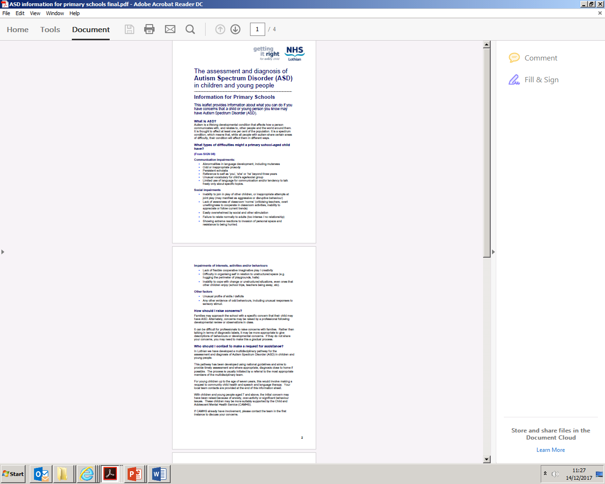


Improving recognition by referrers
http://www.autismstrategyscotland.org.uk/strategy/key-documents.html

Slide 25



Autism ACHIEVE Alliance
Thank you!

Slide 26
References
Autism Achieve Alliance Publications list (available from authors)
Jacobson, J.W., Mulick, J.A. (2000). System and cost research issues in treatments for people with autistic disorders. J Autism Dev Disord,30:585–593.
Le Couteur, A. (chair of the Core Working Group) (2003). National autism plan for children (NAP-C): Plan for the identification, assessment, diagnosis and access to early interventions for pre-school and primary school aged children with autism spectrum disorders (ASD). London, UK: The National Autistic Society.
National Institute for Health and Clinical Excellence (2011). Autism: recognition, referral and diagnosis of children and young people on the autism spectrum [CG128]. London: National Institute for Health and Clinical Excellence
National Institute for Health and Clinical Excellence (2012). Autism: recognition, referral, diagnosis and management of adults on the autism spectrum [CG142]. London: National Institute for Health and Clinical Excellence.
Palmer, E., Ketteridge, C., Parr, J.R., Baird, G., & Le Couteur, A. (2011). Autism spectrum disorder diagnostic assessments: improvements since publication of the National Autism Plan for Children. Arch Dis Child, 96:473–475.
Quine, L., & Rutter, D.R. (1994). First diagnosis of severe mental and physical disability: a study of doctor-parent communication. Journal of Child Psychology and Psychiatry, 35(7):1273-1287.
Reichow, B. (2009). Comprehensive synthesis of early intensive behavioral interventions for young children with autism based on the UCLA Young Autism Project model. Journal of Autism and Developmental Disorders, Vol 39(1):23-41.
Scottish Government (2011a). The Scottish Strategy for Autism. Edinburgh: HMSO.
Scottish Intercollegiate Guidelines Network (SIGN) (2007). Assessment, diagnosis and clinical interventions for children and young people with autism spectrum disorders. Edinburgh. (SIGN publication no. 98).
Contact: firefly@qmu.ac.uk

Slide 27


Autism ACHIEVE Alliance
Thanks!

