Slide 1


Autism ACHIEVE Alliance
Identifying ASD in girls across contexts
Marion Rutherford 2018

Slide 2
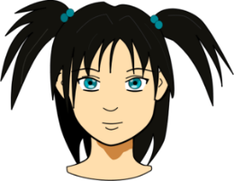
Autism is Autism
Diagnostic criteria are not gender specific
Each of the criteria must be present
There is no such thing as an autistic behaviour
If we understand the criteria more fully, we recognise more variants of ASD

Slide 3
DSM5
Social communication and interaction
Restricted, repetitive behaviour, interests, or activities and sensory behaviours

Slide 4
Typical boys
ASD boys
ASD girls
Typical girls

Slide 5
Outcomes for women with ASD
A higher proportion of women (83%) than men (67%) reported having a mental health condition.
Women with ASD appear to be more socially isolated
  52% stating that they were happy with their current level of friendships and social activities
  In contrast 67% of men reported they were happy with their social experience

Slide 6
Delayed diagnosis, Under-diagnosis and mis-diagnosis
  Girls diagnosed on average 2 years later than boys
  In children 4 boys:1 girl
  We are probably missing the girls
  Gender ratio reduces with age – in adults 2 male: 1 female
  Some exceptions
  In Learning Disability the ratio is 1.9:1
  In Edinburgh data showed 2.7:1 diagnosed in 2016

Slide 7
Video Clip
Selective Attention Video Clip

Slide 8
Selective attention
We see what we are looking for
Notes:
If people don’t expect to autism in girls they don’t see it

Slide 9
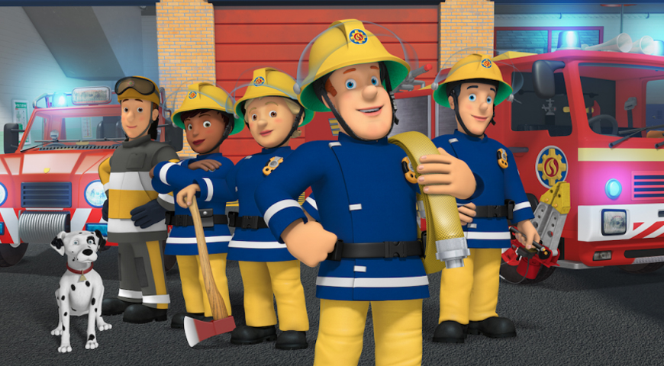
Gender differences nature or nurture?

Slide 10
‘Girl’ and ‘Boy’ special interests:
Are they intense and persistent?
Trains
Hoovers
Minecraft
Computer games
Dinosaurs
Washing machines
Animals
Lip balm collections
Make-up
Pop stars
‘Pink’
Princesses
Sensory properties of things (fluffy textures shiny labels)

Slide 11
So… how do girls present?

Slide 12
Camouflage hypothesis:
  Good at imitation (e.g. pretend play, group interaction)
  Quick to apologise and apease - “people pleasers” so unexpected behaviour can be overlooked
  May have one special “intense”, or “dependent” friendship
  Quiet, well behaved and compliant
  (avoidant of drawing attention)
  Coping strategies might hide difficulties
  (e.g. reading to opt out of interaction)
  Misdiagnosed (language delay, eating disorder, anxiety)
  Special interests - imitated or more socially expected
  Difficulty identifying and dealing with social conflict

Slide 13
Masking and Camouflaging
Hull, L., Petrides, K.V., Allison, C. et al. J Autism Dev Disord (2017) 47: 2519. https://doi.org/10.1007/s10803-017-3166-5
  Hull et al.,(2017). “Putting on my best normal”: social camouflaging in adults with autism spectrum conditions. Journal of autism and developmental disorders, 47(8), 2519-2534.
  Exhaustion after social stimulation (school, playgroups) – e.g. come home and sleep for 2 hours
  Anxiety, depression, self harm because of not ever feeling she fits in and that she never get’s it quite right
  Bullying – online or real world
  Socially vulnerable – do what others say/ trusting/ not able to work out other’s intentions as good/bad

Slide 14
Younger girls
Sensory issues—intolerance of crowds or of certain sounds or textures, for example (this can continue through life)
Sleep problems greater in girls with ASD
Difficulties in imagination may present more in novel or social situations (e.g. imagining what a friend would like to play, imagining how someone else feels, imagining what school trips will be like)
May seem anxious or seem to opt out/ avoid new situations
May seem socially successful but again consider the quality of the friendships
  Are girl peer groups being more accepting/ nurturing?
  Are these adult supported friendships/ routines

Slide 15
Younger girls
Possibly at-age or above-age language use, but perhaps echolalia, stereotyped phrases or differences in receptive/expressive language
Special interests –imitated or more socially expected
Good at imitation (e.g. pretend play, group interaction)
Overtly good imaginative play - but if we watch we can see a difference in quality of play – repetitive, scripted, copied, inflexible, other children accommodate to them
  It’s not what they are interested in but the quality of their play and interaction we need to observe
  ‘Would she play like that all day if you let her?’

Slide 16
Older girls
NB. Camouflaging continues even when we come to assess
Show higher social motivation and greater capacity for friendship than boys with ASD
May develop one strong / intense friendship
Have less apparent/ different restrictive interests and repetitive behaviours
May be embarrassed and stimming or following interests in private
Internalize emotions—which could spur anxiety, depression or eating disorders—in contrast to males’ externalizing behaviour that shows up as hyperactivity or noncompliant behaviour

Slide 17
Older girls
‘Coke can’ behavior—following rules at school and being the “ideal student,” then coming home and melting down or having tantrums.
  Be aware of school reports that there are no concerns with strong parent concerns
Difficulty with conversation skills and social engagement— ‘transmit only’, not asking other people about themselves, turn-taking, staying on topic, initiating and contributing to the conversation in an expected way
‘Over-sharing’ personal information
Difficulty identifying and dealing with social conflict
Low self-esteem – may do anything to be accepted by peers
Use DSM-5 as a guide, not a look for hard-and-fast requirement

Slide 18
Finally
Girls are under-recognised – be aware
Autism is autism
Look for quality of interaction, friendships and interests
Consider reasons for anxiety
The autism lens is always helpful

