Slide 1


Autism ACHIEVE Alliance
Taking an ASD specific developmental history
Notes:
Session 5: 1.30-2.15

Slide 2
ASD specific developmental history assessment
Components of ASD diagnostic assessment
ASD Specific History
History-taking Tools
Mapping to DSM 5 Diagnostic criteria
Red Flags
Notes:
If we gather this information as part of developmental assessment for children about whom ASD has been raised as a concern, we are beginning to collect the information required to make a diagnosis.
The alternative is a general history with key questions missing, leading to a need to repeat developmental history. Parents don’t appreciate going over same ground several times, slows process

Slide 3
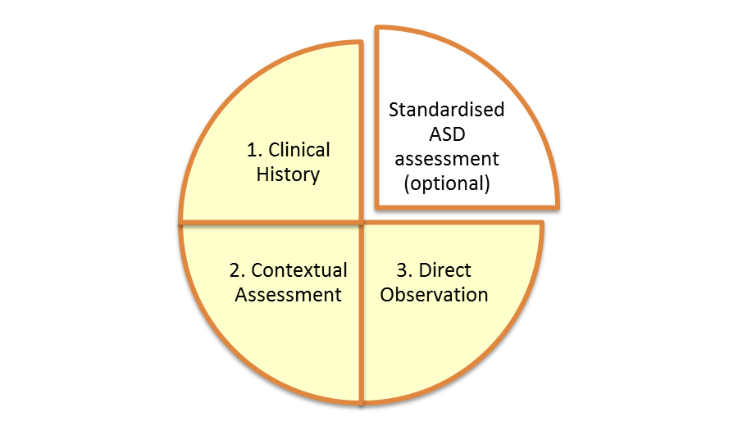
Components of assessment
+ DSM 5 or ICD

Slide 4
Clinical History
Pregnancy/pre conception health and habits
Alcohol/Cigarettes/medication
Foetal growth concerns
Delivery and after
Early infant feeding and behaviour
Maternal health and mental health
Postnatal depression/attachment
Family situation and set up
DRAW A FAMILY TREE

Slide 5
Clinical History
Enquire about and assess the following:
Core autism signs and symptoms
  Difficulties in social interaction and communication
  Stereotypic behaviour, resistance to change or restricted interests; hyper and hypo sensitivities to environment and attention to detail

Slide 6
Clinical History
Early developmental history and regression
Behavioural challenges and main areas of concern
Functioning at home and in education
Past and current physical health
Past and current psychological health
Family history of neuro developmental conditions
Family history of ASD
Family history of schizophrenia/bipolar affective disorder
EMPLOY ACTIVE LISTENING

Slide 7
Tools for taking a developmental history
Standardised Tools
ADI-r Autism Diagnostic Schedule (revised)
DISCO
Non-standardised pro-formas
National Autism Plan for Children
Oregon interview (based on DSM-5)
Local Proformas

Slide 8
DSM-5 Mapping Evidence:
A. Deficits in use or understanding of social communication and social interaction in multiple contexts, not accounted for by general developmental delays, and manifest by all 3 of the following:

Slide 9
DSM-5
A1 Deficits in nonverbal communicative behaviours used for social interaction; ranging from poorly integrated verbal and nonverbal communication, through abnormalities in eye contact and body-language, or deficits in understanding and use of nonverbal communication, to total lack of facial expression or gestures.

Slide 10
Questions/probes for A1
Eye contact – parent report/your own observation
Pointing to show or request – if no point how?
Conventional gestures
Descriptive gestures
Attention to voice
Response to his/her name being called
Understanding of facial expression
Use of facial expression

Slide 11
DSM 5
A2 Deficits in social-emotional reciprocity; ranging from abnormal social approach and failure of normal back and forth conversation through reduced sharing of interests, emotions, and affect and response to total lack of initiation of social interaction.

Slide 12
Questions/probes for A2
Initiating interaction
Quality of social overtures
Interest in thoughts/feelings of others
Seeking information on others
Sharing information eg declaring an injury etc
Joint attention/shared enjoyment
Sharing
Offering comfort

Slide 13
DSM 5
A3 Deficits in developing and maintaining relationships appropriate to developmental level (beyond those with caregivers); ranging from difficulties adjusting behaviour to suit different social contexts through difficulties in sharing imaginative play and in making friends to an apparent absence of interest in people

Slide 14
Questions/probes for A3
Friendships
Parties/play dates
Transitions
Non routine events
Imaginative play
Reporting behaviour of others to parent
Interest in others

Slide 15
DSM-5 Mapping Evidence:
B. Restricted, repetitive patterns of behaviour, interests, or activities as manifested by 2 of the following:

Slide 16
DSM 5 B1
1. Stereotyped or repetitive speech, motor movements, or use of objects; (such as simple motor stereotypies, echolalia, repetitive use of objects, or idiosyncratic phrases)

Slide 17
Questions/probes for B1
Echolalia – immediate or delayed
Use of jargon
Stereotypical speech
Idiosyncratic use of language
Accent/prosody/volume modulation
Motor stereotypies eg flap, flick, hand mannerisms

Slide 18
DSM 5
B2. Excessive adherence to routines, ritualized patterns of verbal or nonverbal behaviour, or excessive resistance to change; (such as motoric rituals, insistence on same route or food, repetitive questioning, or extreme distress at small changes)

Slide 19
Questions/probes for B2
Routine bound eg same route insistence
Eating – limited dietary repertoire
Food types, textures, colour preference
Food placement on plate
Clothes and dressing
Toileting
Sleep
Transitional objects

Slide 20
DSM 5
B3 Highly restricted, fixated interests that are abnormal in intensity or focus; (such as strong attachment to or preoccupation with unusual objects, excessively circumscribed or perseverative interests)

Slide 21
Question/probes for B 3
Interests/obsessions
Probe as to transitory or long standing
Monologuing or ‘transmit only’
Collecting/sorting/naming
Probe for rigidity/distress if not able to pursue the interest
Probe for interest in all situations

Slide 22
DSM 5
B4 Hyper-or hypo-reactivity to sensory input or unusual interest in sensory aspects of environment; (such as apparent indifference to pain/heat/cold, adverse response to specific sounds or textures, excessive smelling or touching of objects, fascination with lights or spinning objects).

Slide 23
Questions/probes for B 4
Noise tolerance eg hoover, hand dryer
Strong sense of smell
Adverse response to environment eg textures, smells etc
Fascinations eg lights, spinning objects
Excessive smelling/licking objects
Seeking deep pressure eg pressing,kneading
High pain threshold

Slide 24
Know your red flags
Signs and symptoms of possible autism in secondary school children (older than 11 years or equivalent mental age)
NICE CG 128
Difficulty interacting with others, lack of ‘social imagination’
Reduced or absent awareness of personal space, or unusually intolerant of people entering their personal space.
Long-standing difficulties in reciprocal social communication and interaction: few close friends or reciprocal relationships.
Reduced or absent understanding of friendship; often an unsuccessful desire to have (although may find it easier with adults or younger children).
Social isolation and apparent preference for aloneness.
Unable to adapt style of communication to social situations, for example may be overly formal or inappropriately familiar, or ‘unexpected actions’
Subtle difficulties in understanding other's intentions; may take things literally and misunderstand sarcasm or metaphor

