Slide 1


Autism ACHIEVE Alliance
Clinical Observations in Autism Assessment

Slide 2
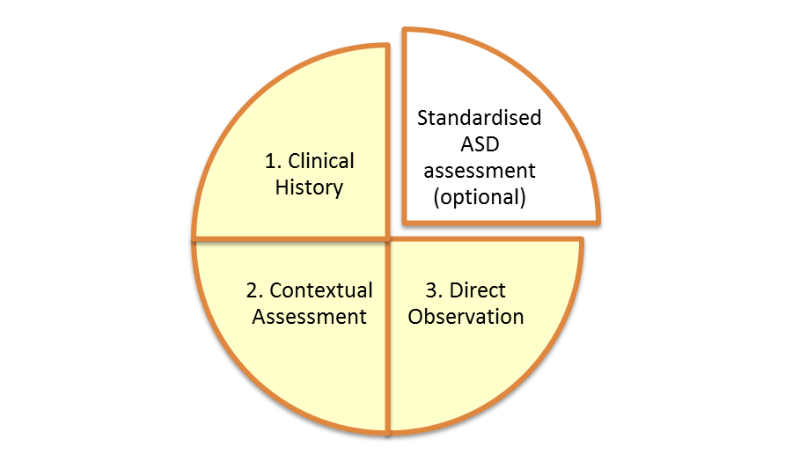
Clinical Observations
What to look for in a clinical observation
How to look for it - tools to use
‘Pressing’

Slide 3
DSM 5 observations
A) Social communication and interaction
Non verbal communication used for social interaction
Social-emotional reciprocity
Social approach with others – do they initiate, engage, respond?
Failure of normal back-and-forth conversation/ play
Reduced sharing of interests, emotions, or affect (e.g. showing toys to parents)
Reduced eye gaze to initiate, maintain or terminate and interaction?
Reading facial expressions, body language and emotions in others?
Use and understanding of pointing and other gestures? (Is pointing to request or to share interest?)

Slide 4

DSM 5 observations
A) Social Communication and Interaction
Developing, maintaining, and understanding relationships
Difficulties adjusting behaviour to suit different social contexts
Evidence of early symbolic/ imitative play; creative or imaginative play and sharing imaginative play with others
Able to follow others’ agenda?

Slide 5
DSM 5 observations
B) Restricted and repetitive patterns of behaviour
  Stereotyped or repetitive motor movements, use of objects, or speech
Highly restricted, fixated interests that are abnormal in intensity or focus
simple motor stereotypies
echolalia (immediate/delayed)
idiosyncratic phrases (repetitive or stereotypical language, any unusual intonation?)
body movements and hand mannerisms
strong attachment to or preoccupation with unusual objects

Slide 6
DSM 5 Restricted and repetitive patterns of behaviour
Response to sensory input or unusual interests in sensory aspects of the environment
Insistence on sameness, inflexible adherence to routines, or ritualized patterns of verbal or nonverbal behaviour
Type of play preferred (free play)
Unusual play (sensory, lining up, interest in parts of objects, repetitive, solitary)
Sensory responses e.g. touch, smell, peering
Distress at changes/ fear of new things or changes to familiar things
How are transitions if not supported? (finishing one thing and moving on to the next)
Give examples of being flexible/ inflexible in thinking and behaviour

Slide 7
What is a ‘press’?
A press provides a higher quality of clinical observation
Be clear exactly what it is we are looking for examples of, rather than just hoping the behaviour will happen to occur
This gets even more essential with older, more able children
Absence of a behaviour is not enough evidence
(e.g. he was not observed to point, initiate, respond to his name, protest when told no….)
We have to be clear that we provided opportunities for the child to do this
(e.g. he was offered a choice of snacks he likes and he looked at them grunted but did not point. Or he pointed but without social eye gaze or I called his name on 5 occasions and he did not respond)

Slide 8
Play based assessment:provide ‘presses’
Stages of play
Sensori-motor play
Organising play
Functional Play
Pretend Play
Social Play:
  Solitary
  Spectator
  Parallel
  Associative
  Cooperative

Slide 9

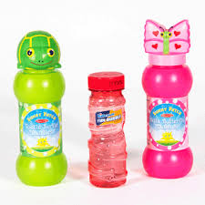

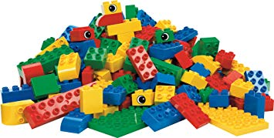
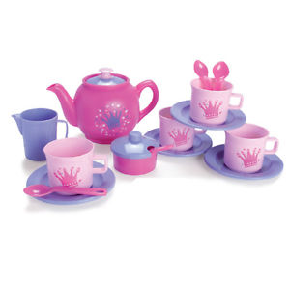
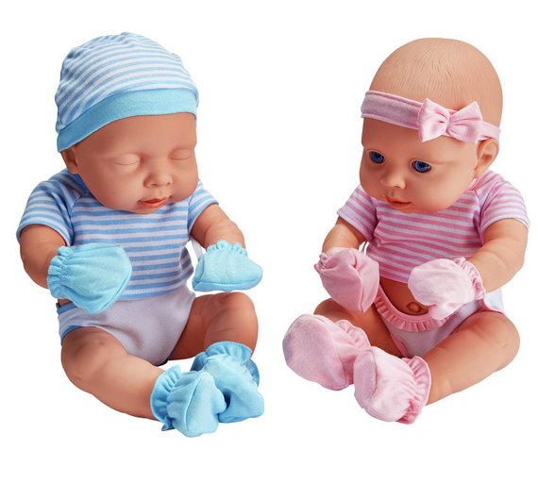
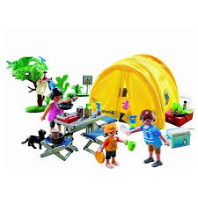
Resources

Slide 10
Aspects to observe & comment on
What does the child do when they come into the room?
What toys, items, people, if any, are they drawn to?
How does the child respond to suggestions/instructions/ pauses in play?
How does the child respond to ‘presses’? e.g. Finishing a task
How does the environment support or inhibit play? Does the child accept adult ‘intrusion’ on play?
How much prompting is required from the adult to achieve something? i.e model/hand over hand
How does interaction compare between clinician and parents/carers?
How does it feel for you?
How long does play last for?

Slide 11
Verbal children
Assessment of theory of mind
Informal assessment of conversation skills
  (vary the topic and who leads; use a press ‘I went on a really exciting holiday last week’)
Non-verbal communication
Play skills
Understanding of social relationships (e.g. friendship)
Spontaneous (not prompted) comments on others emotions

Slide 12
Verbal Children
Happé strange stories
TOM resources
Sequencing
Emotions scenarios (LDA)
Specific tasks – draw their school
Managing a conversation
Giving a personal account
Notes:
The Francesca Happe strange stories can be sued to measure a child’s ability to recognise sarcasm, white lies, avoidance of hurting feelings etc
TOM inventory freely available resource to elicit discussion around emotions, false beliefs, seeing is believing
Sequencing pictures good for general language sample, talk about the future – predicting and also inferring meaning from a picture
Specific tasks eg draw school elicits conversation – ability to describe how to get there, draw any people of merely objects?
Conversation – taking turns when pressed in differing ways – question, leading statement, non-verbal cue. Do they interrupt/dominate?

Slide 13
Benefits and limitations of clinical observation
environment and resources designed to ‘press’ for ASD behaviours
opportunity to observe interaction with parents/carers as well as clinicians
unfamiliar environment
‘snapshot’ in time

